Slide 1
7th Grade Service Learning
Green School Project
HCC Stream Relief
By: CMS Green School

Slide 2
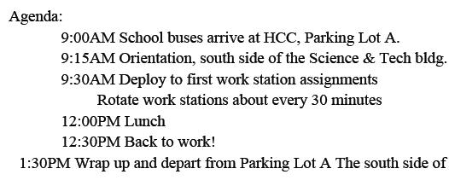
Itinerary

Slide 3
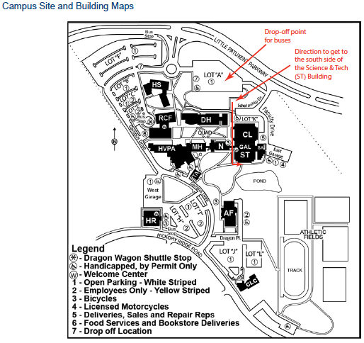
This is the Campus Map

Slide 4
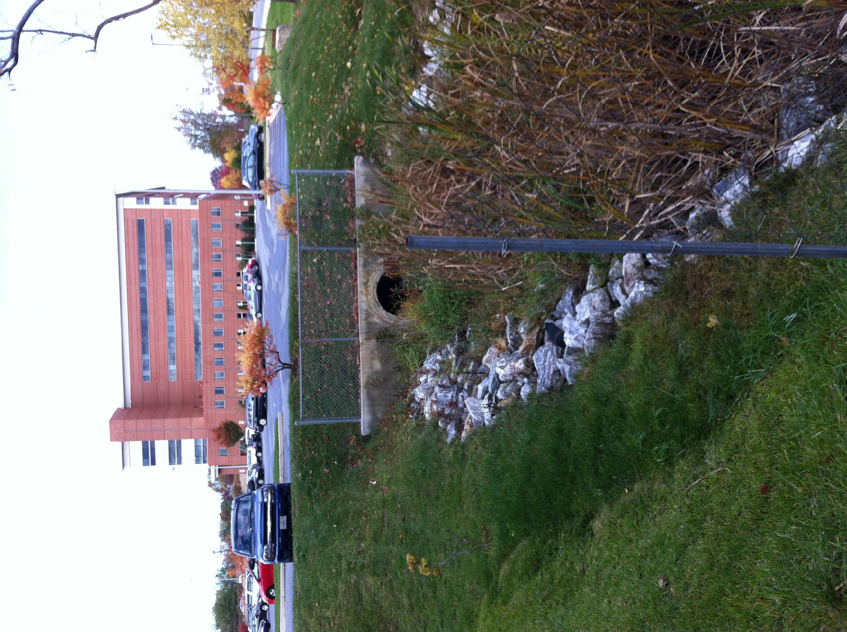
This is the beginning of the Chesapeake Bay
Here: in the middle

Slide 5
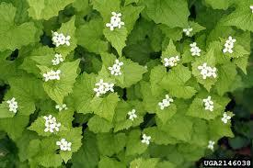
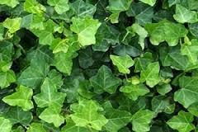
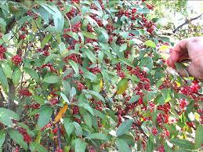
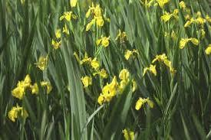
Plants that you will see
1. Garlic Mustard 2. English Ivy
3. Autumn Olive 4. Yellow Iris

Slide 6
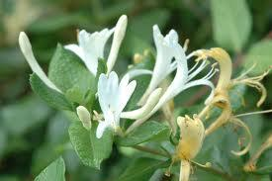
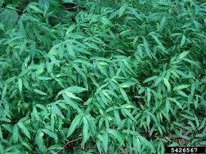
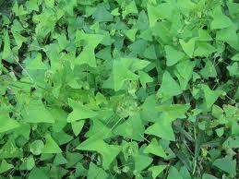
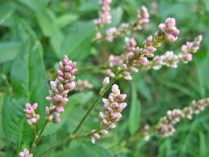
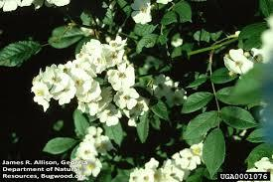
Plants that you will see
5. Japanese Honeysuckle 6. Japanese Stilt Grass
7. Mile-a-minute
8. Blume Oriental Lady’s Thumb 9. Multifolora Rose

Slide 7
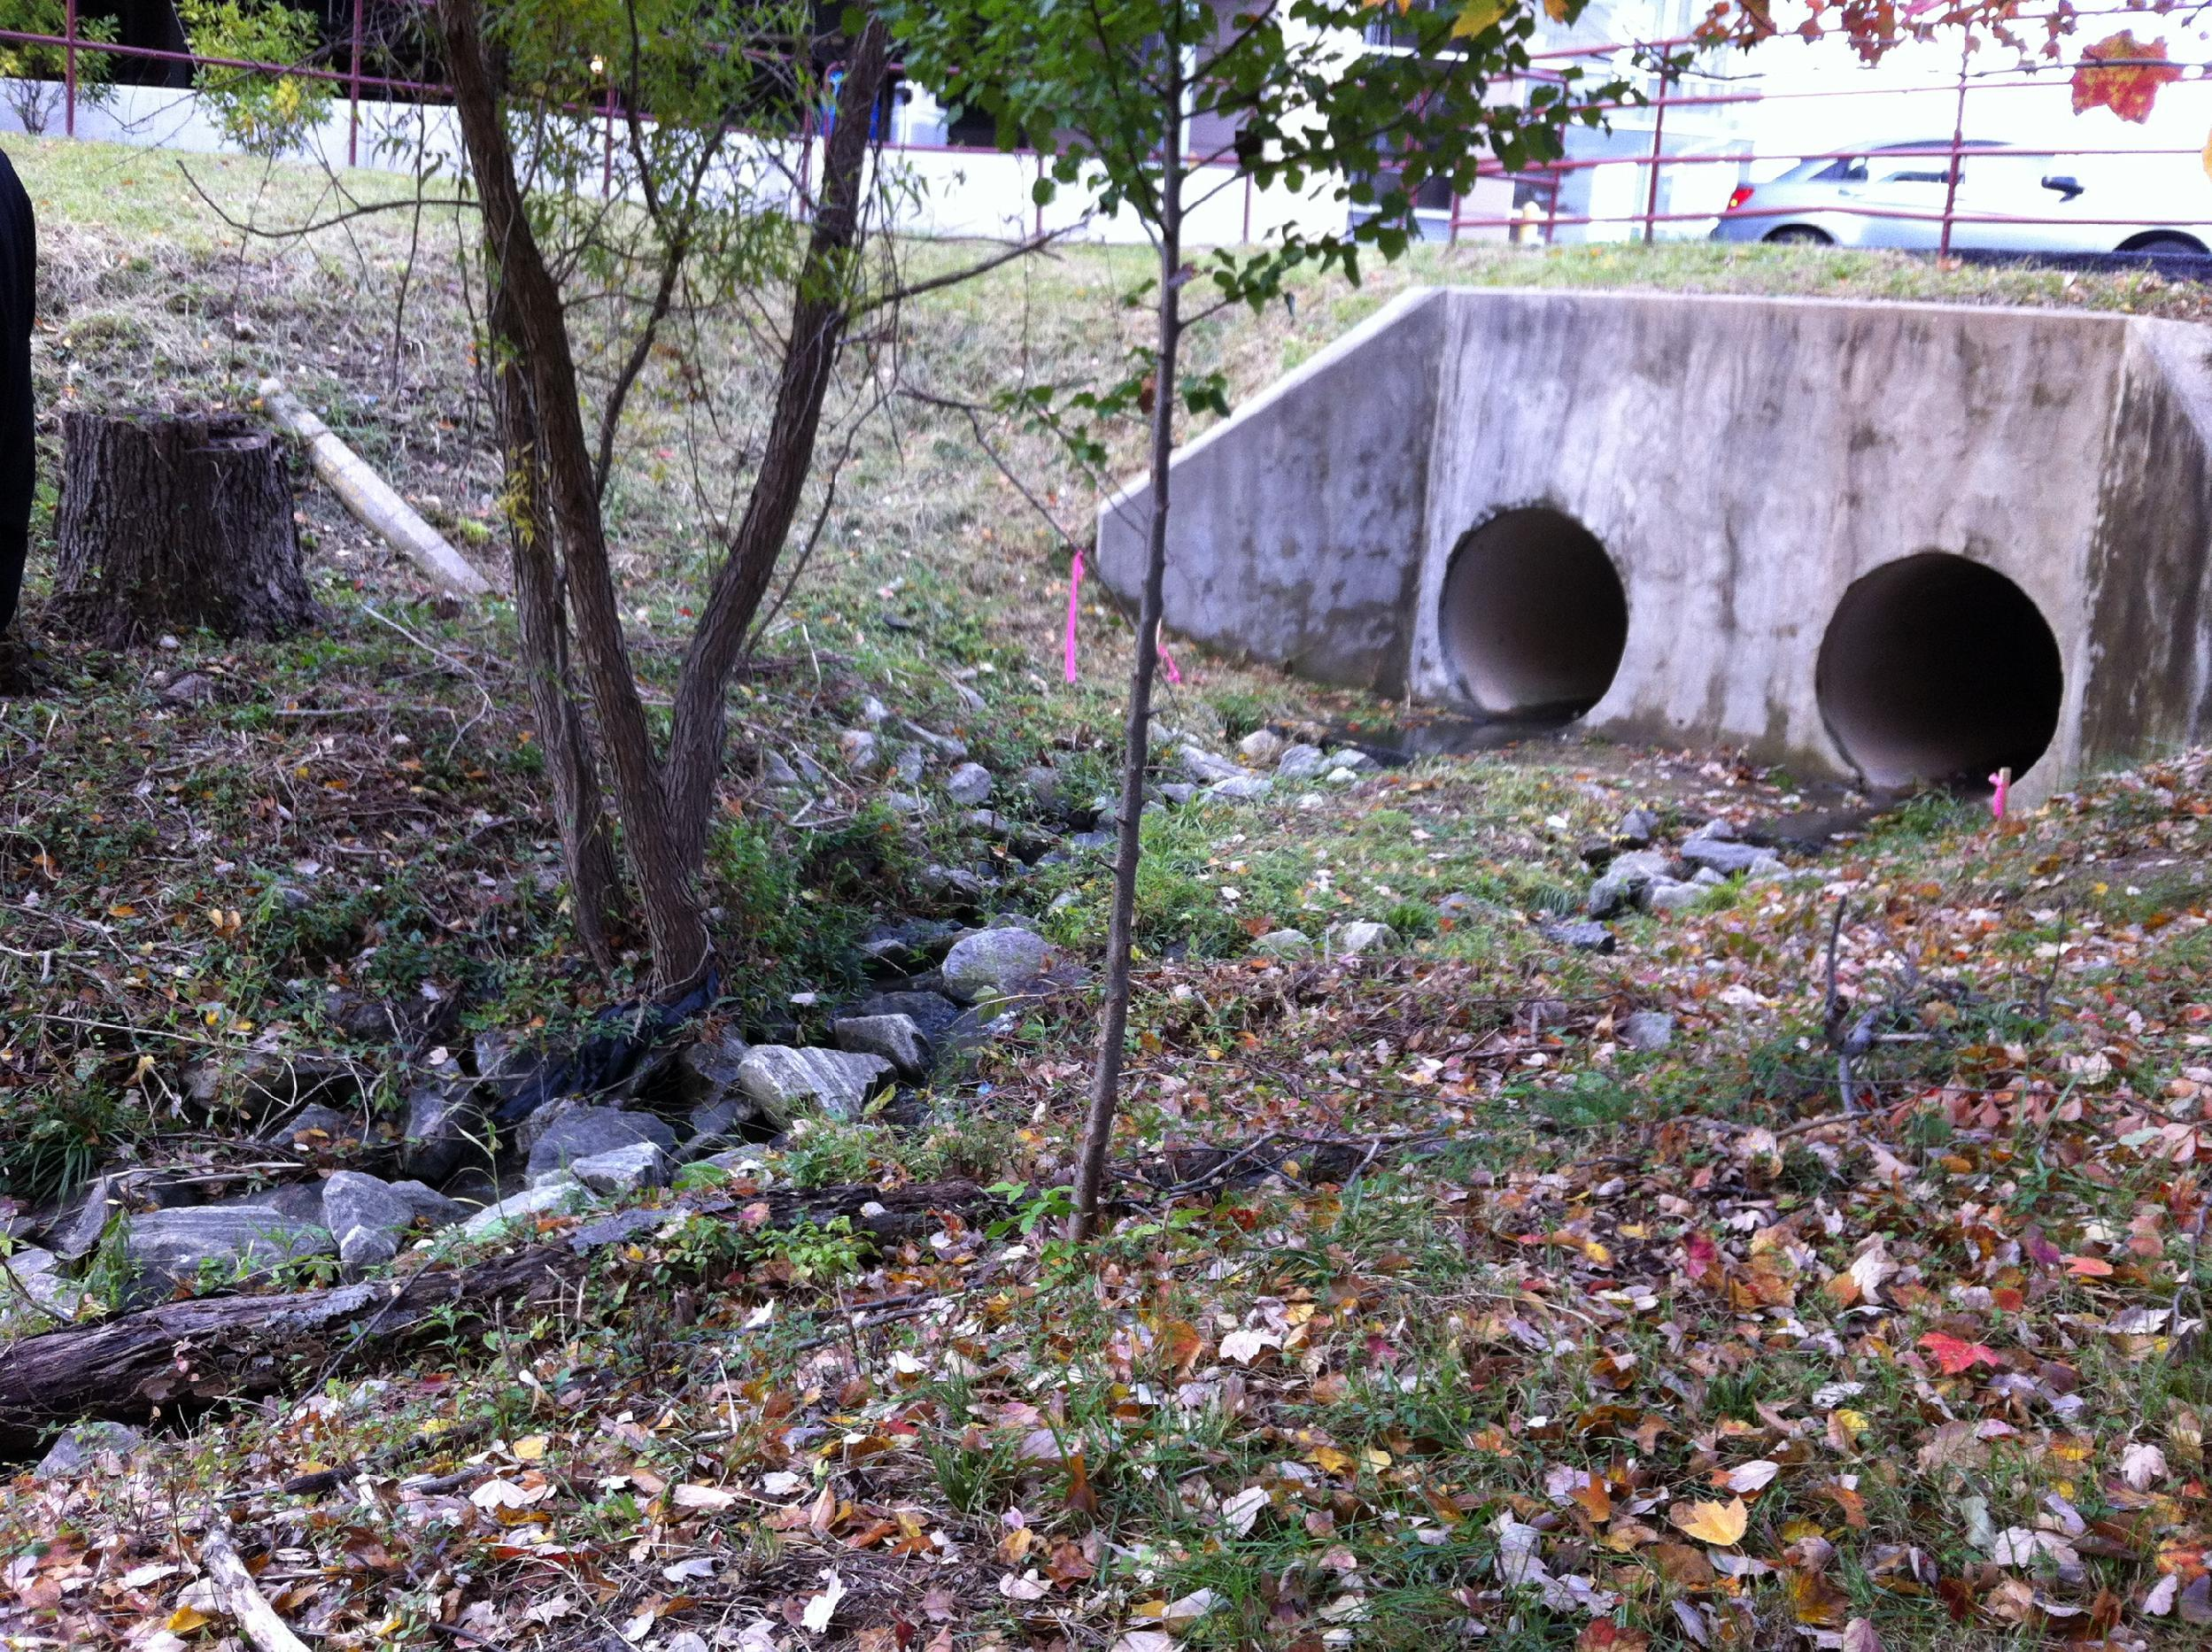
This stream needs to be widened, and there are too many invasive species

Slide 8
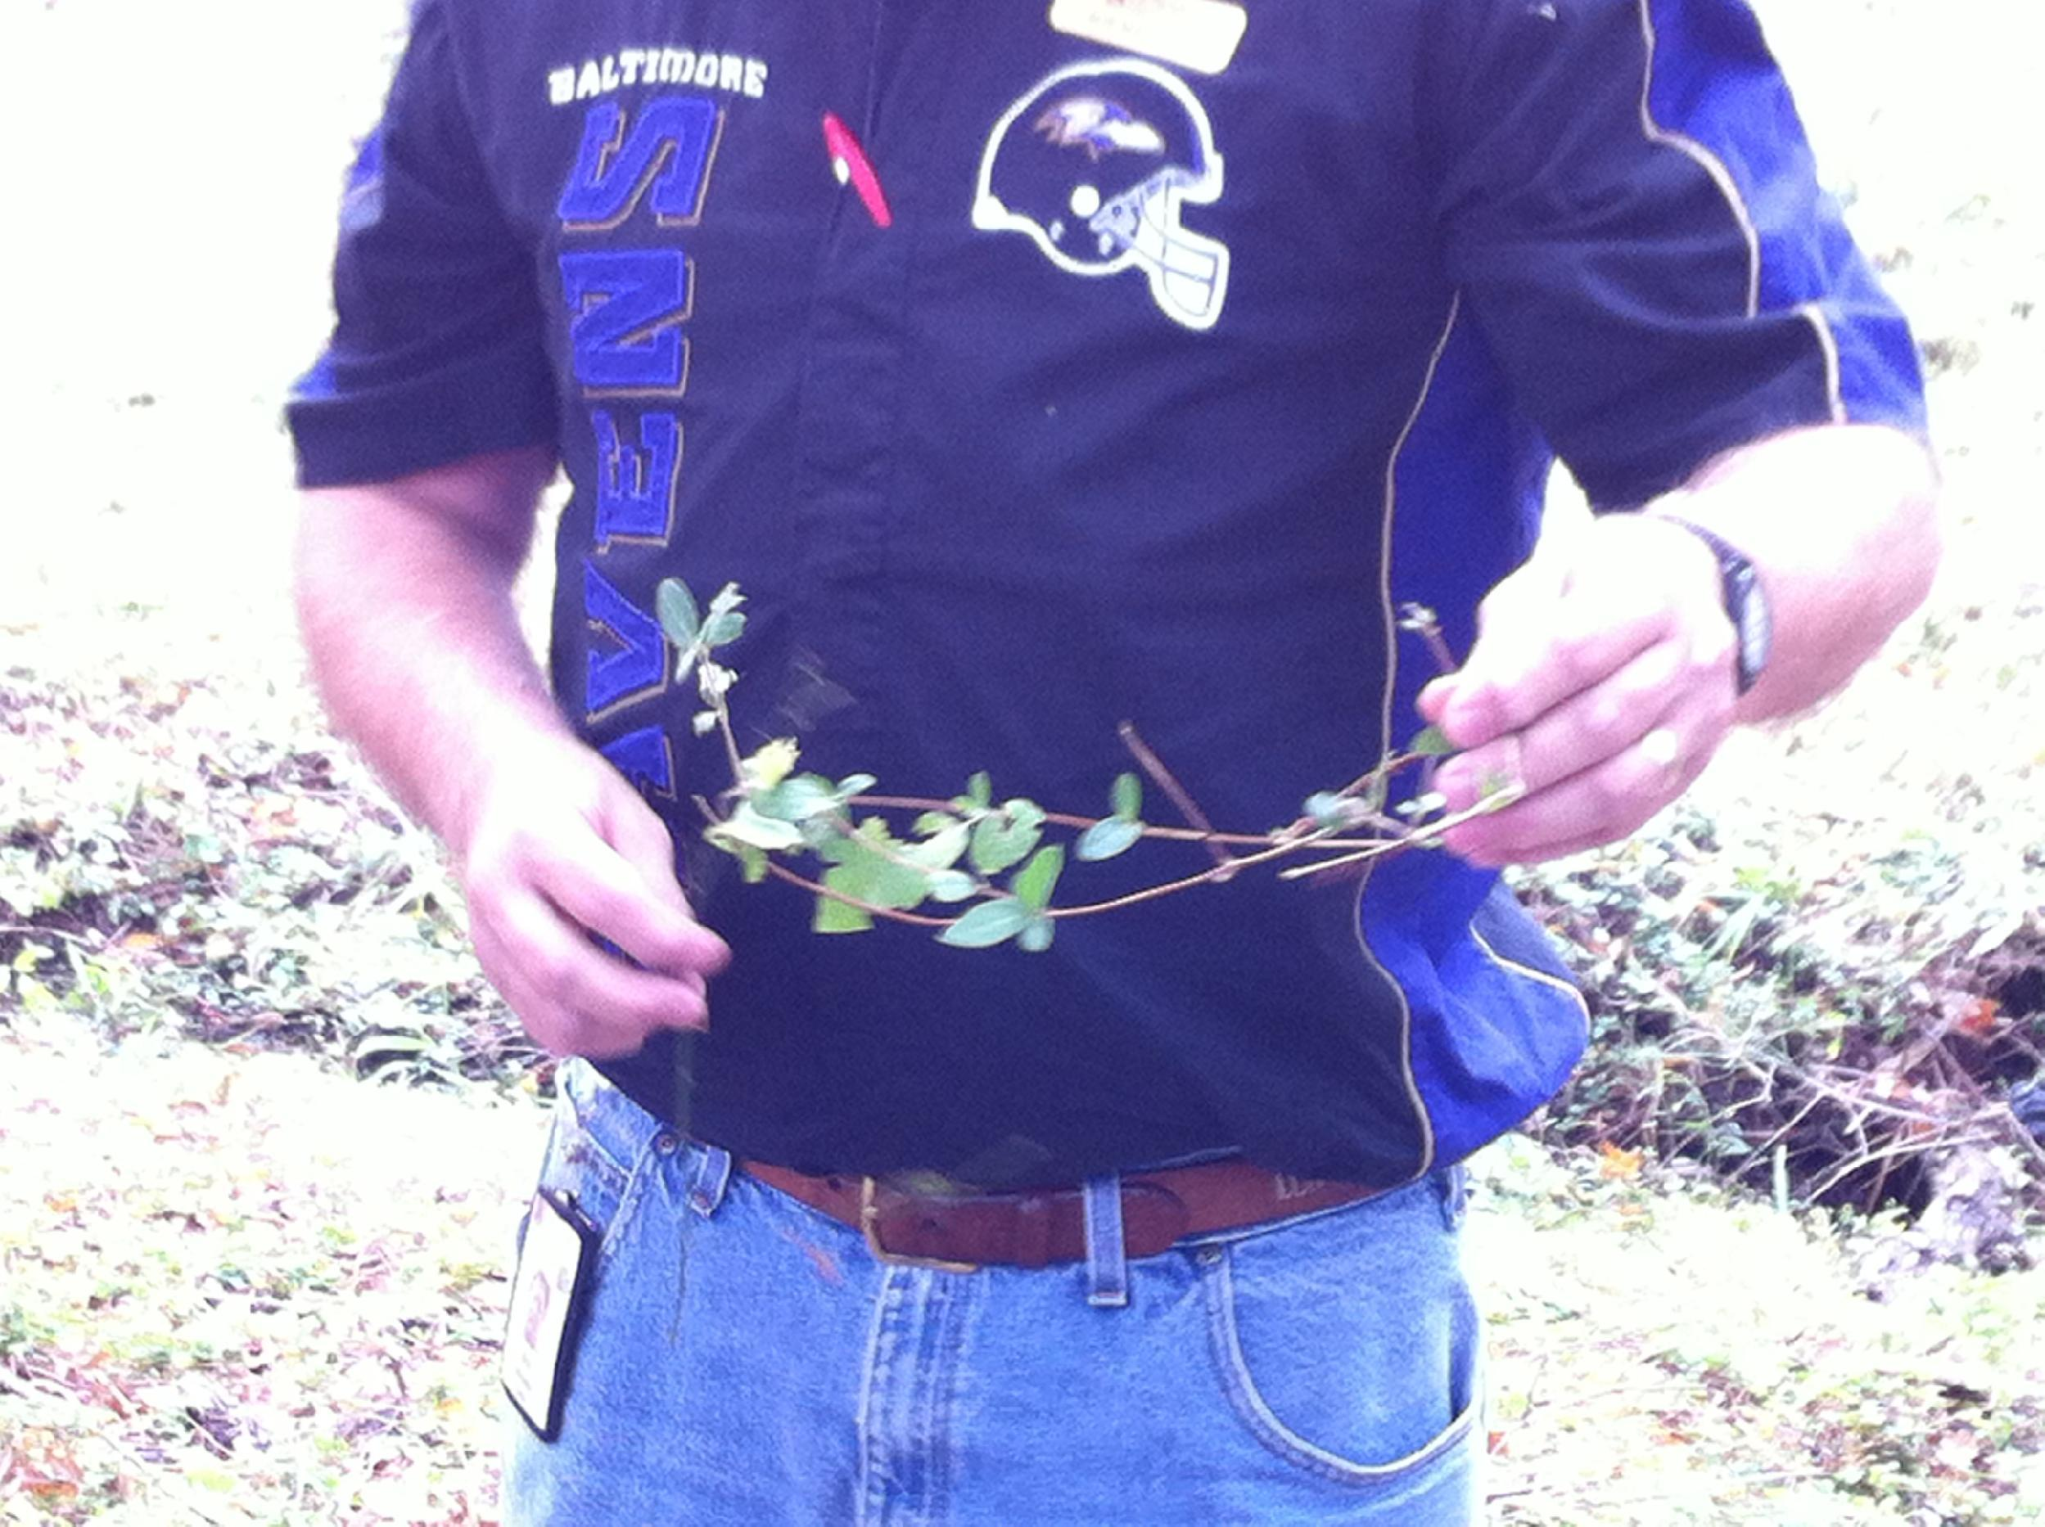
This is one of the invasive plants we will be
pulling out. Invasive plants are plants that are not
native to the area in which they are growing

Slide 9
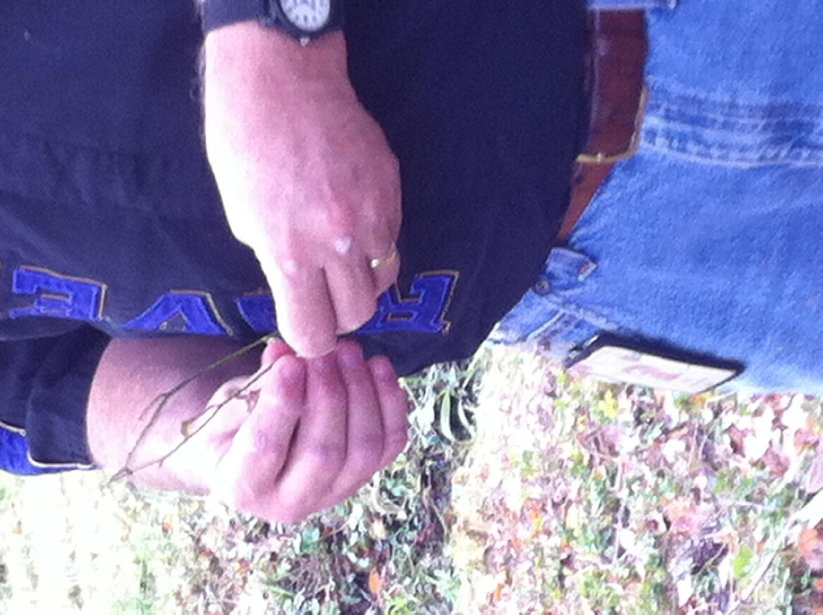
This is another invasive plant that will be removed

Slide 10
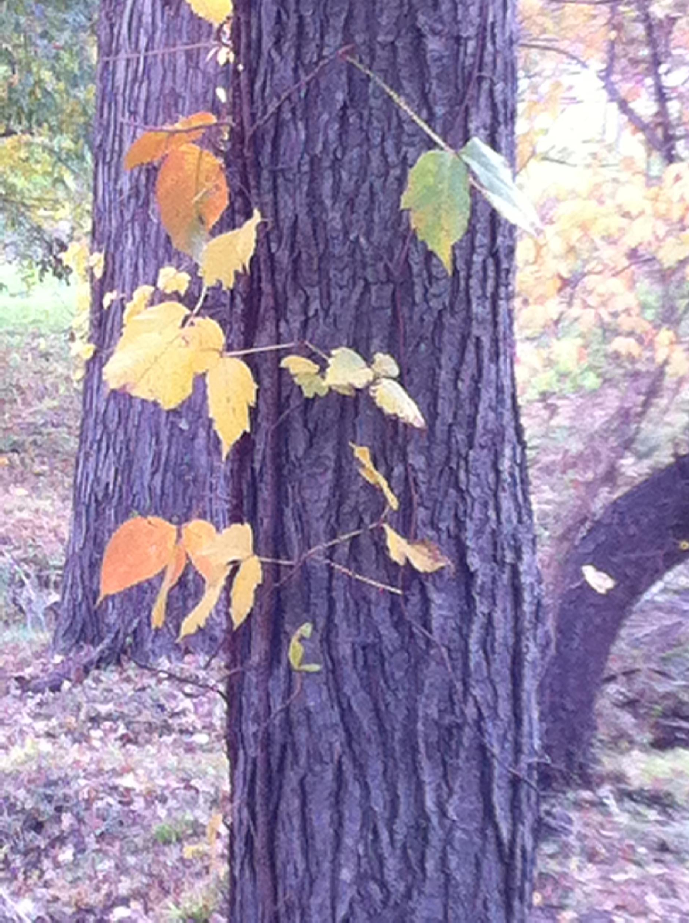
POISON
IVY!
Hairy vines,
Leaves of three,THEN LEAVE IT BE!!

Slide 11
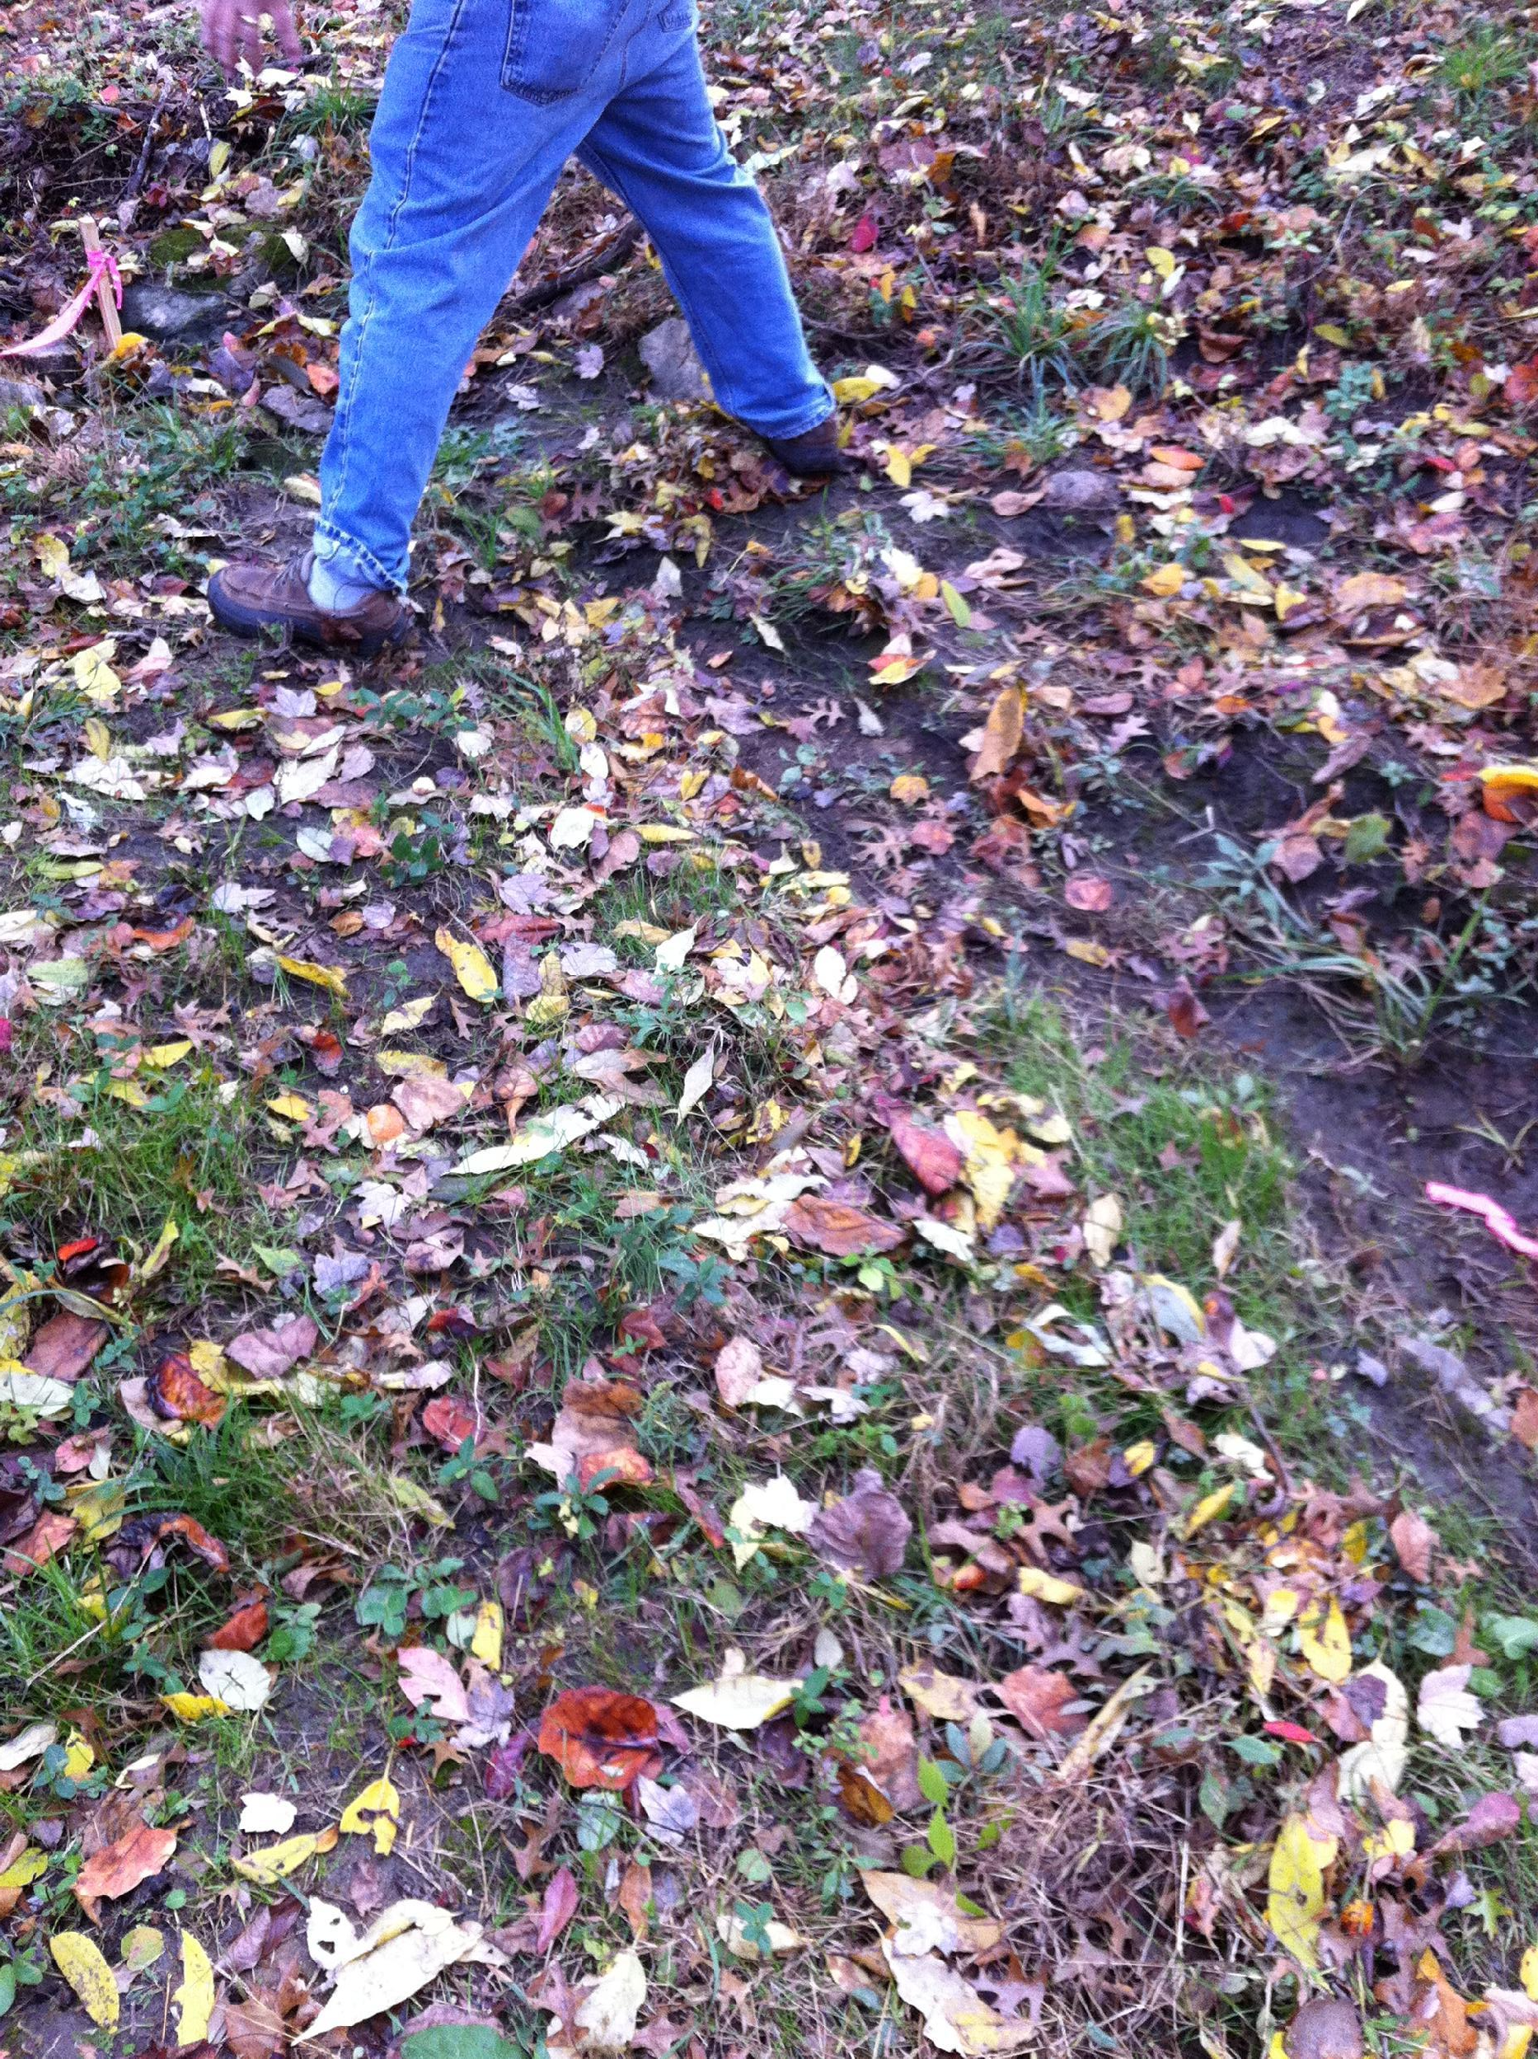
Another part of the stream that is too narrow -
We will widen this to prevent more erosion of sediment

Slide 12
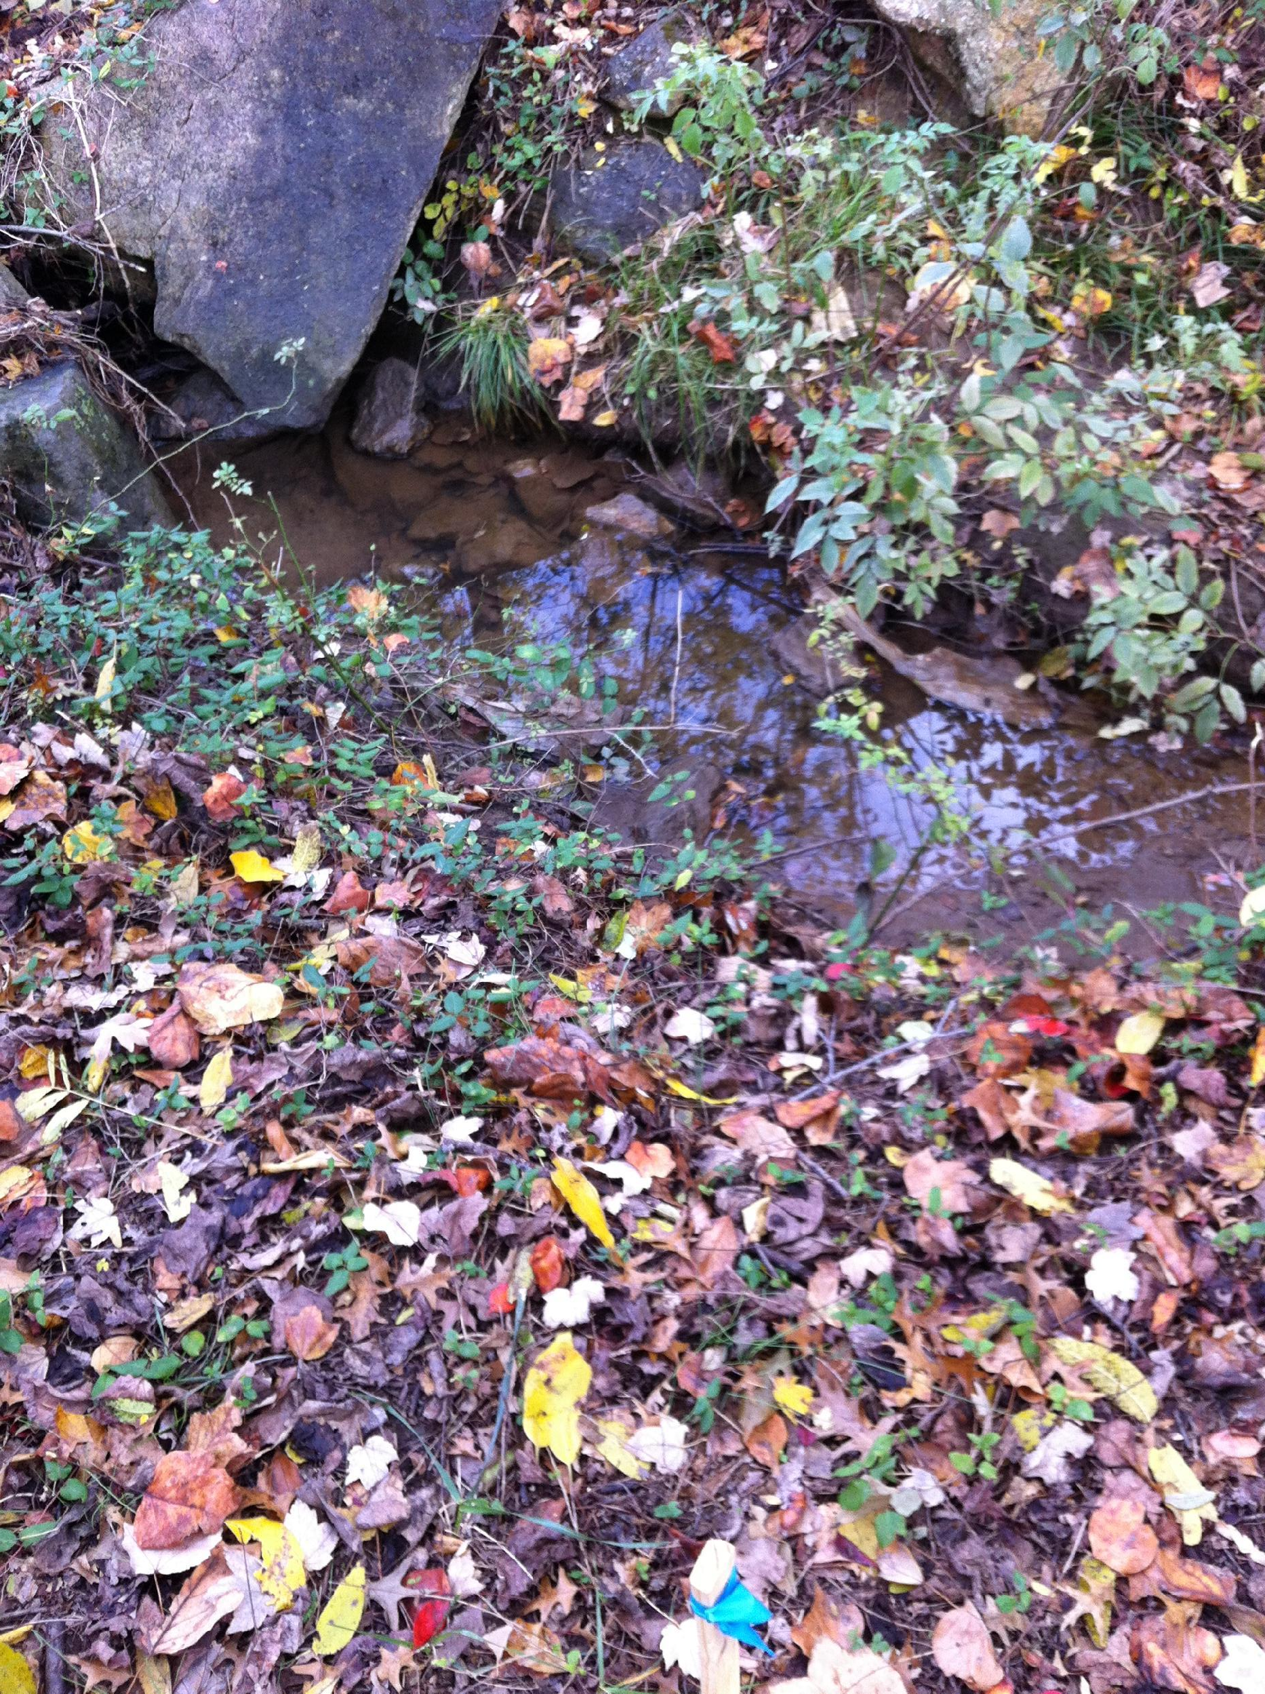
Here, invasive plants must be removed,
the rocks must be moved, and
the stream must be widened

Slide 13
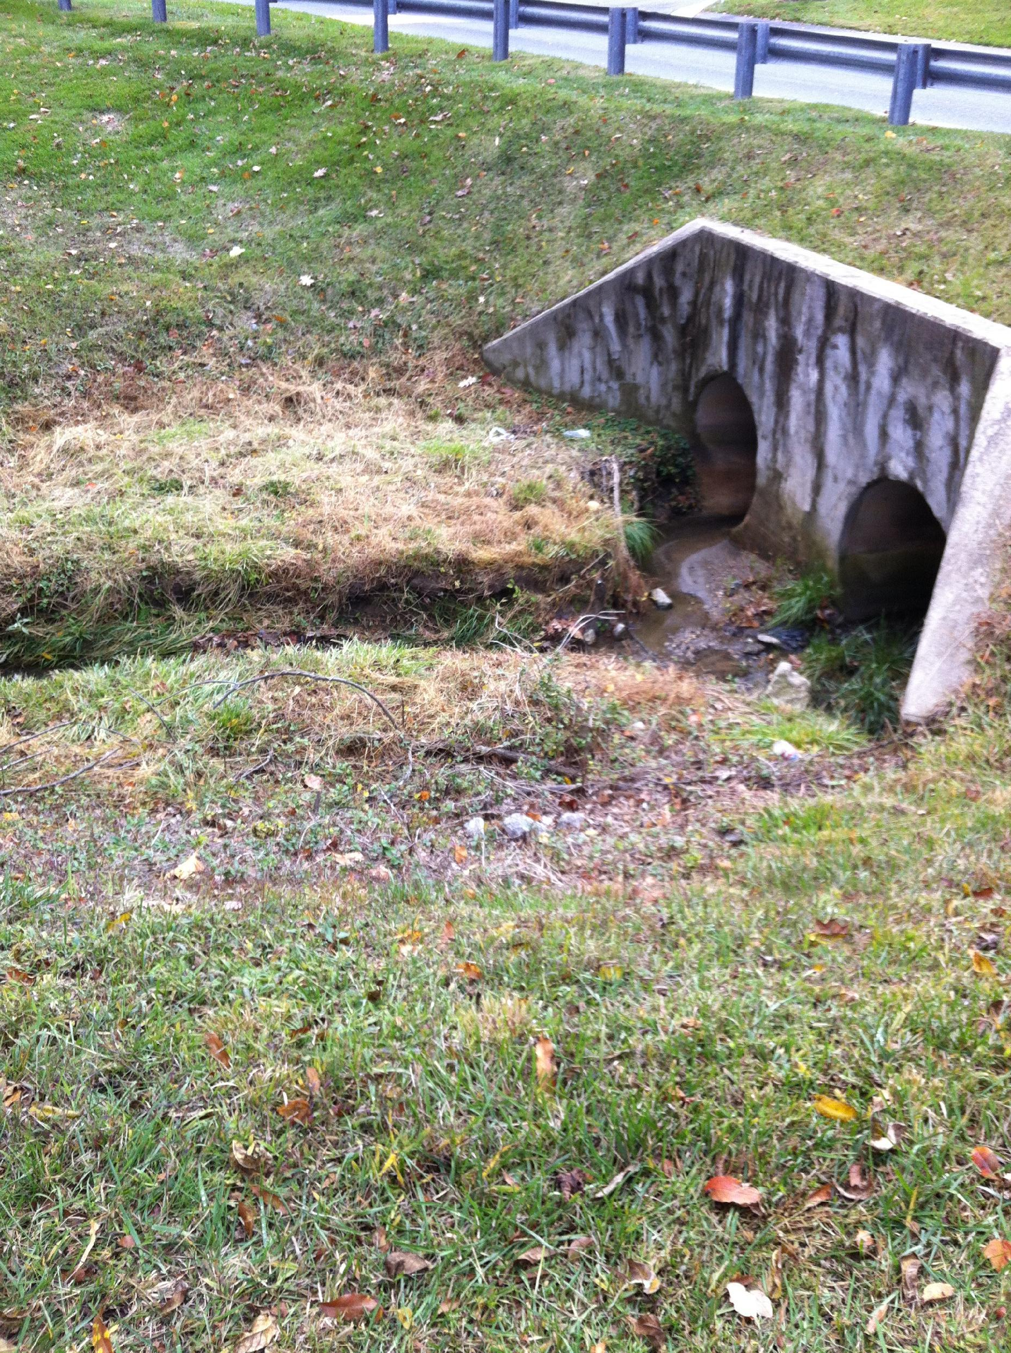
You can see the effects of erosion on this part of the stream
The water is cutting a narrow and deep path into the dirt, taking the soil down to the bay

Slide 14
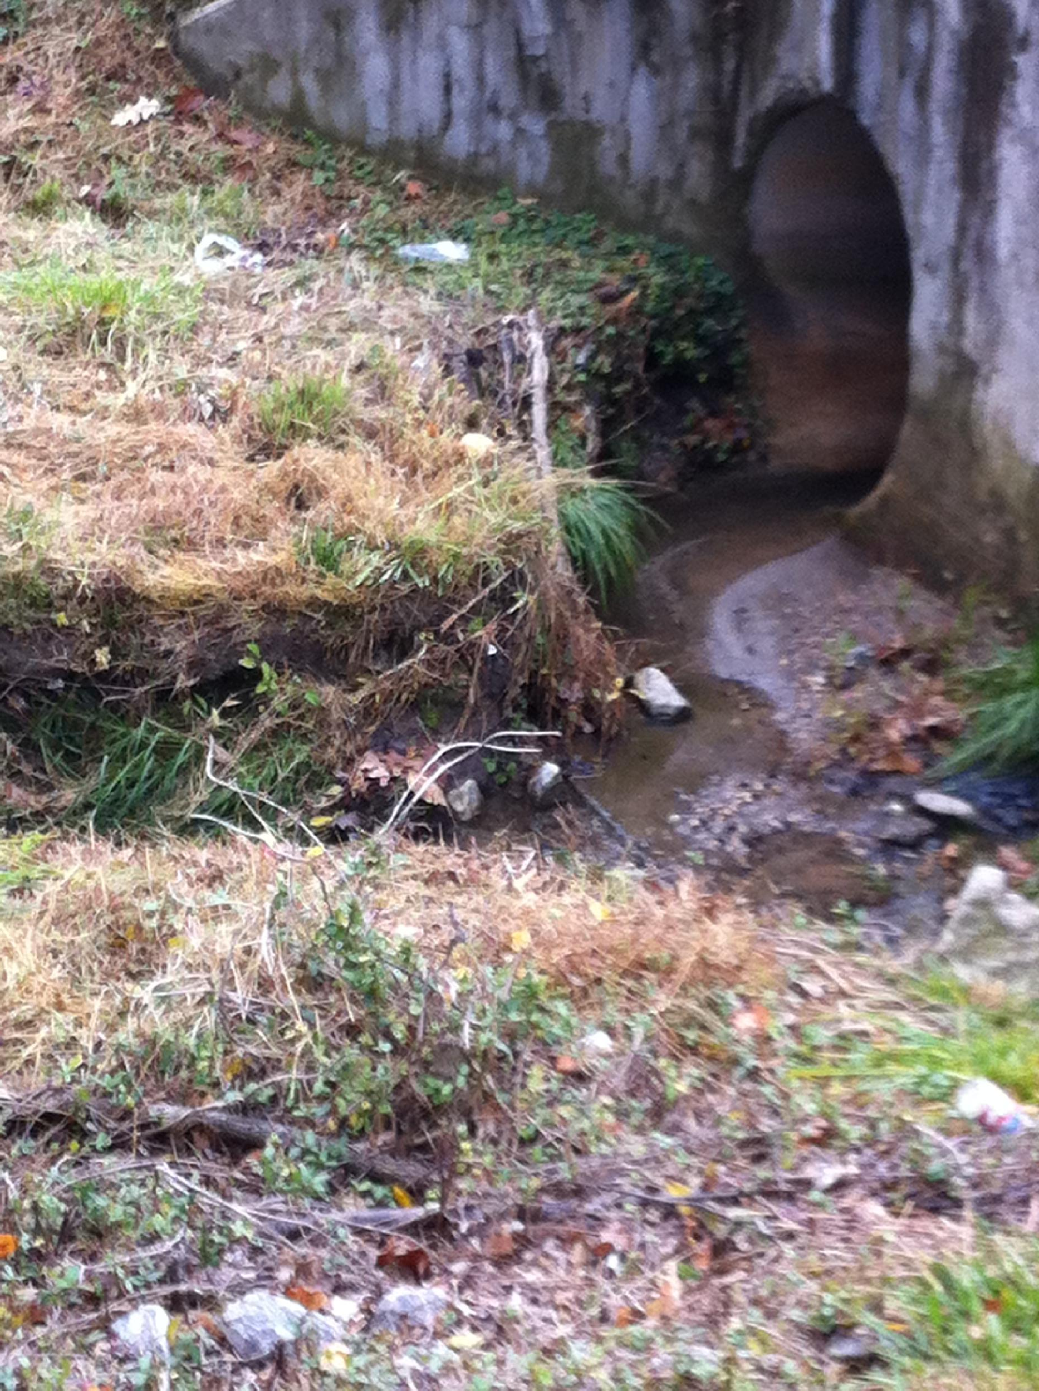
Close up view of erosion. Note the pile of sand and dirt slowly being carried down hill to the bay

Slide 15
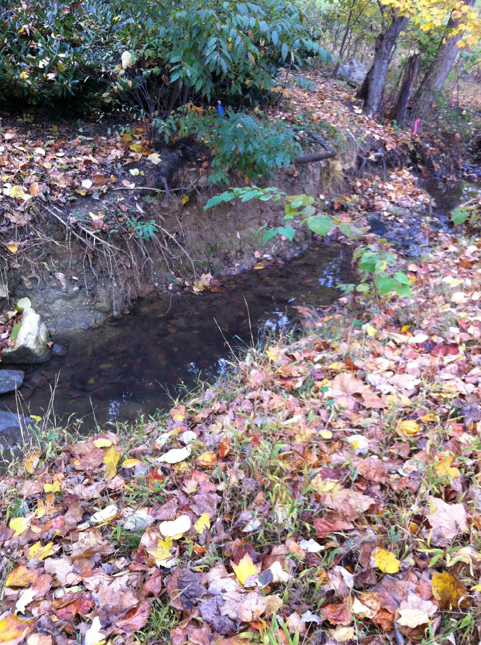
This section of steam is NOT too narrow, but has a lot of invasive plants to be removed
Removing invasives and re-planting native plants is one of our main tasks at HCC

Slide 16
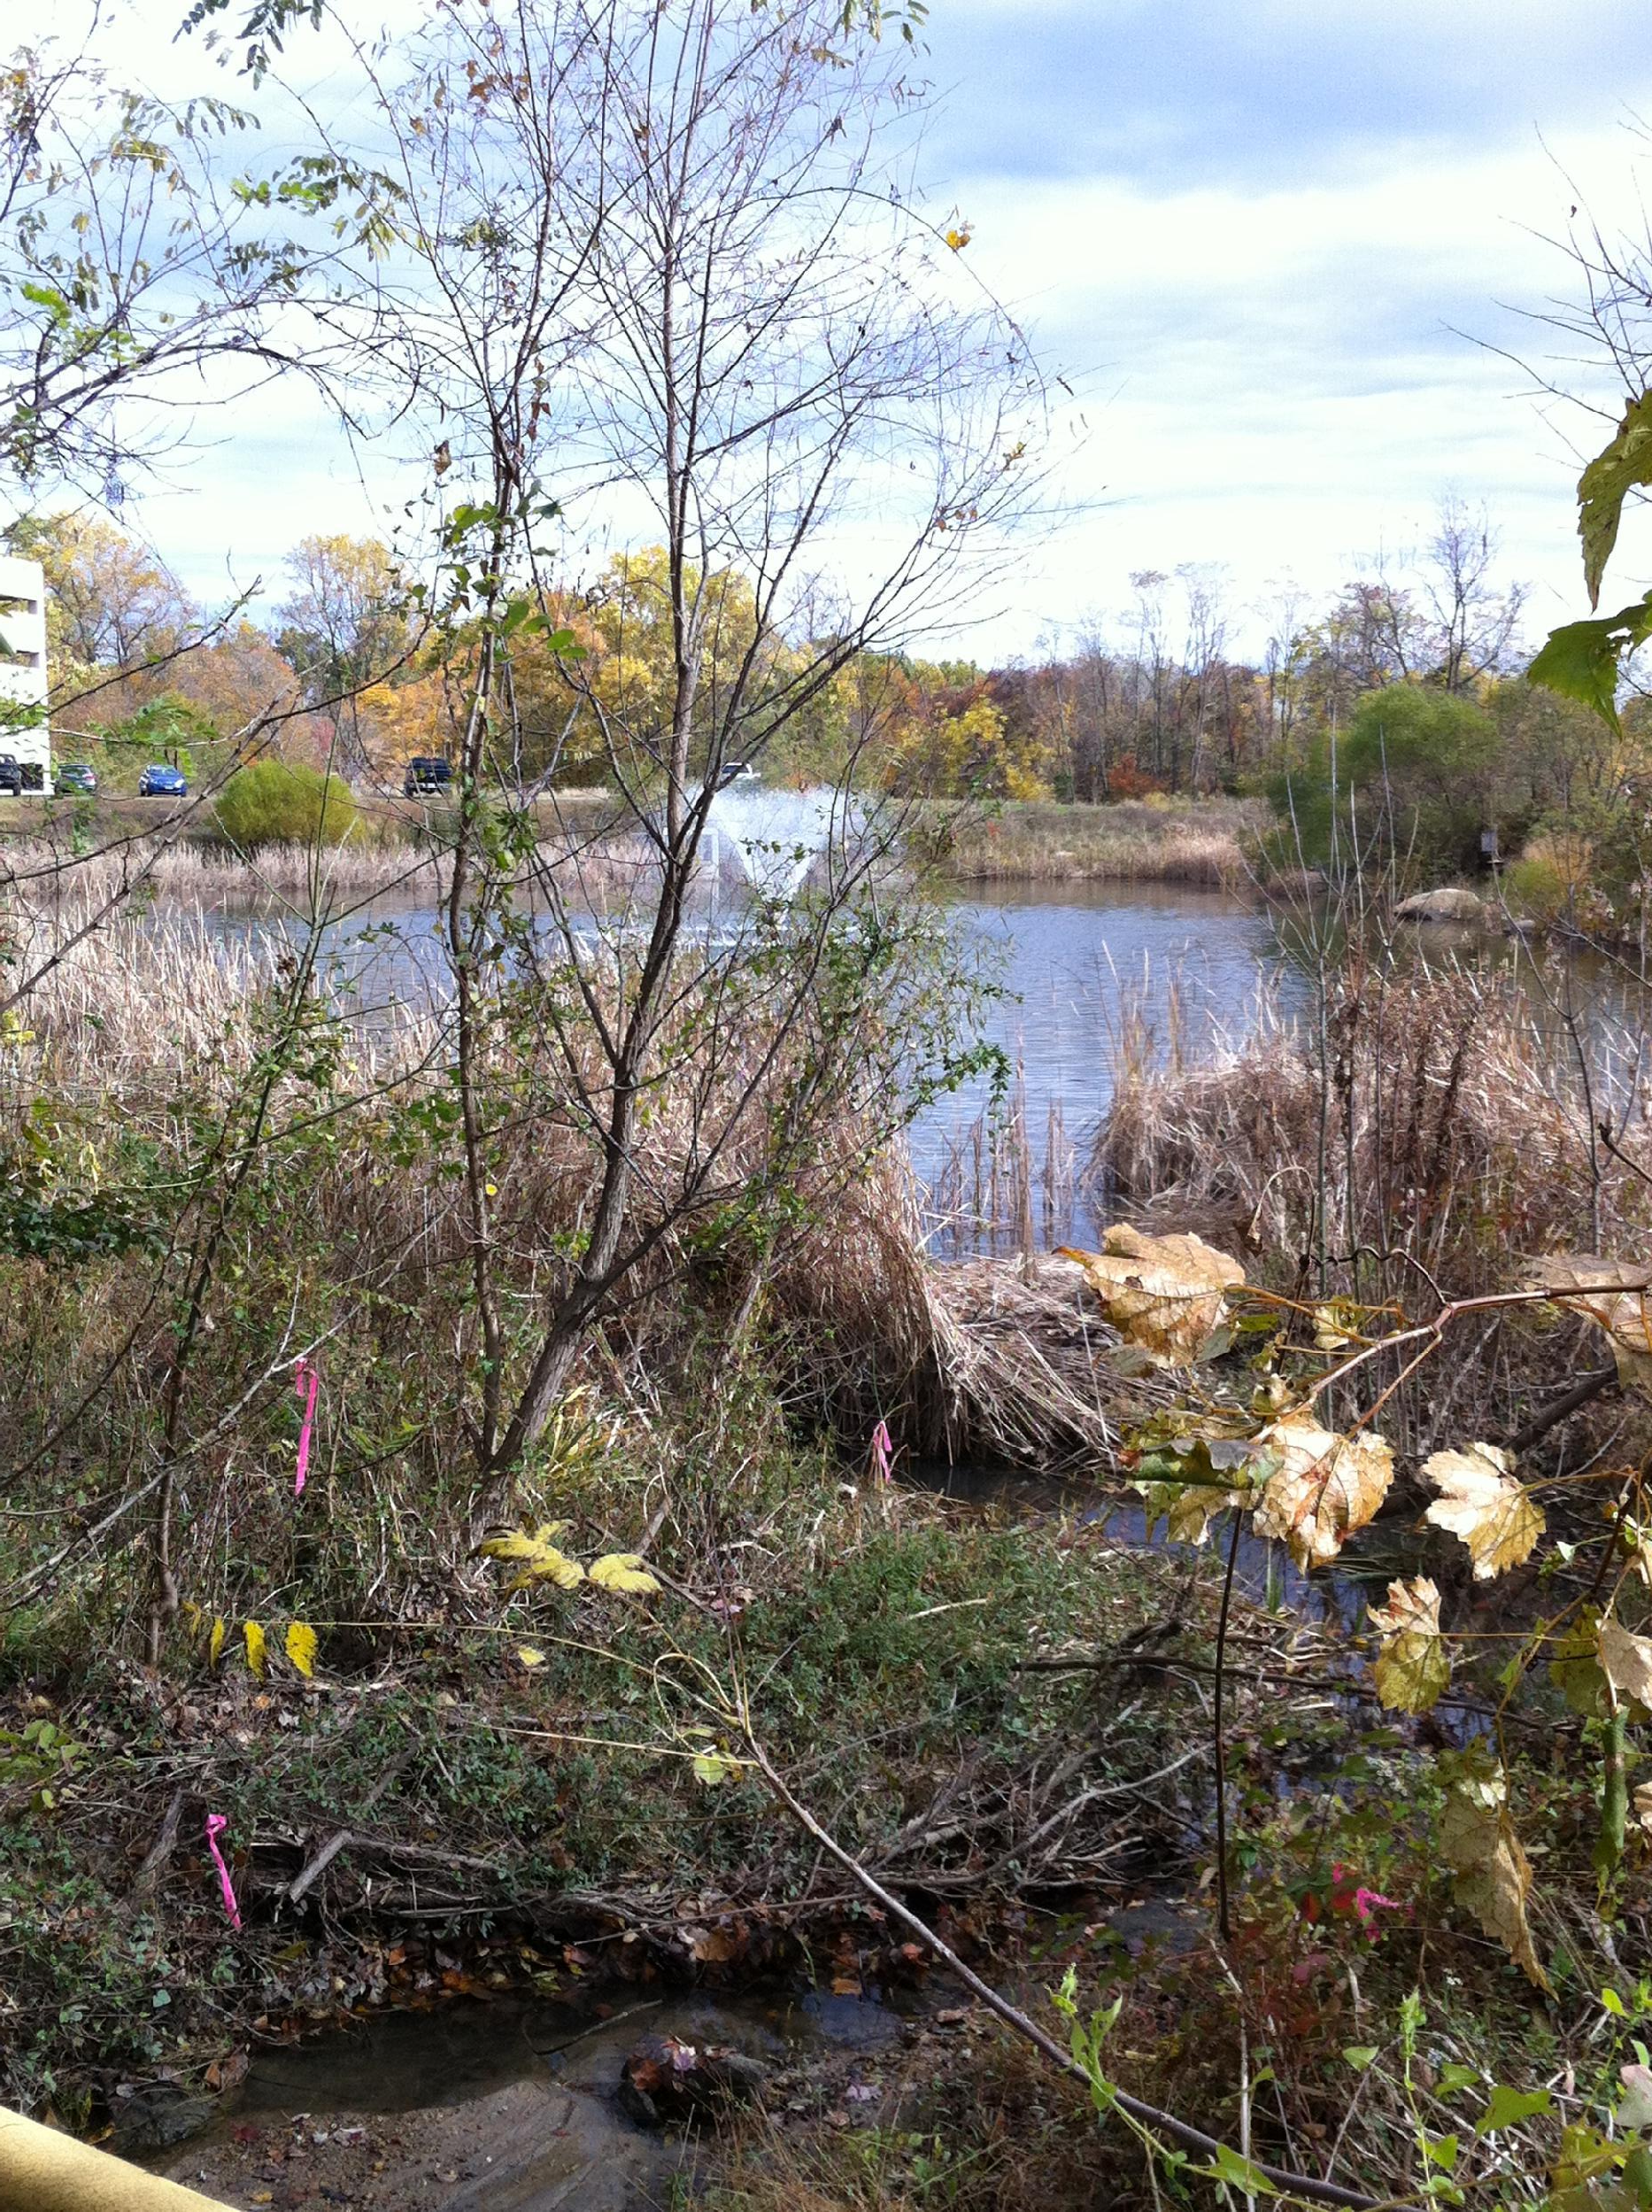
The last pond before water enters the Chesapeake bay. This is the last chance for catching nutrients and filtering water before it goes into the bay
The big machine work crews will build another, smaller pond just before this one, as part of the overall relief project

Slide 17
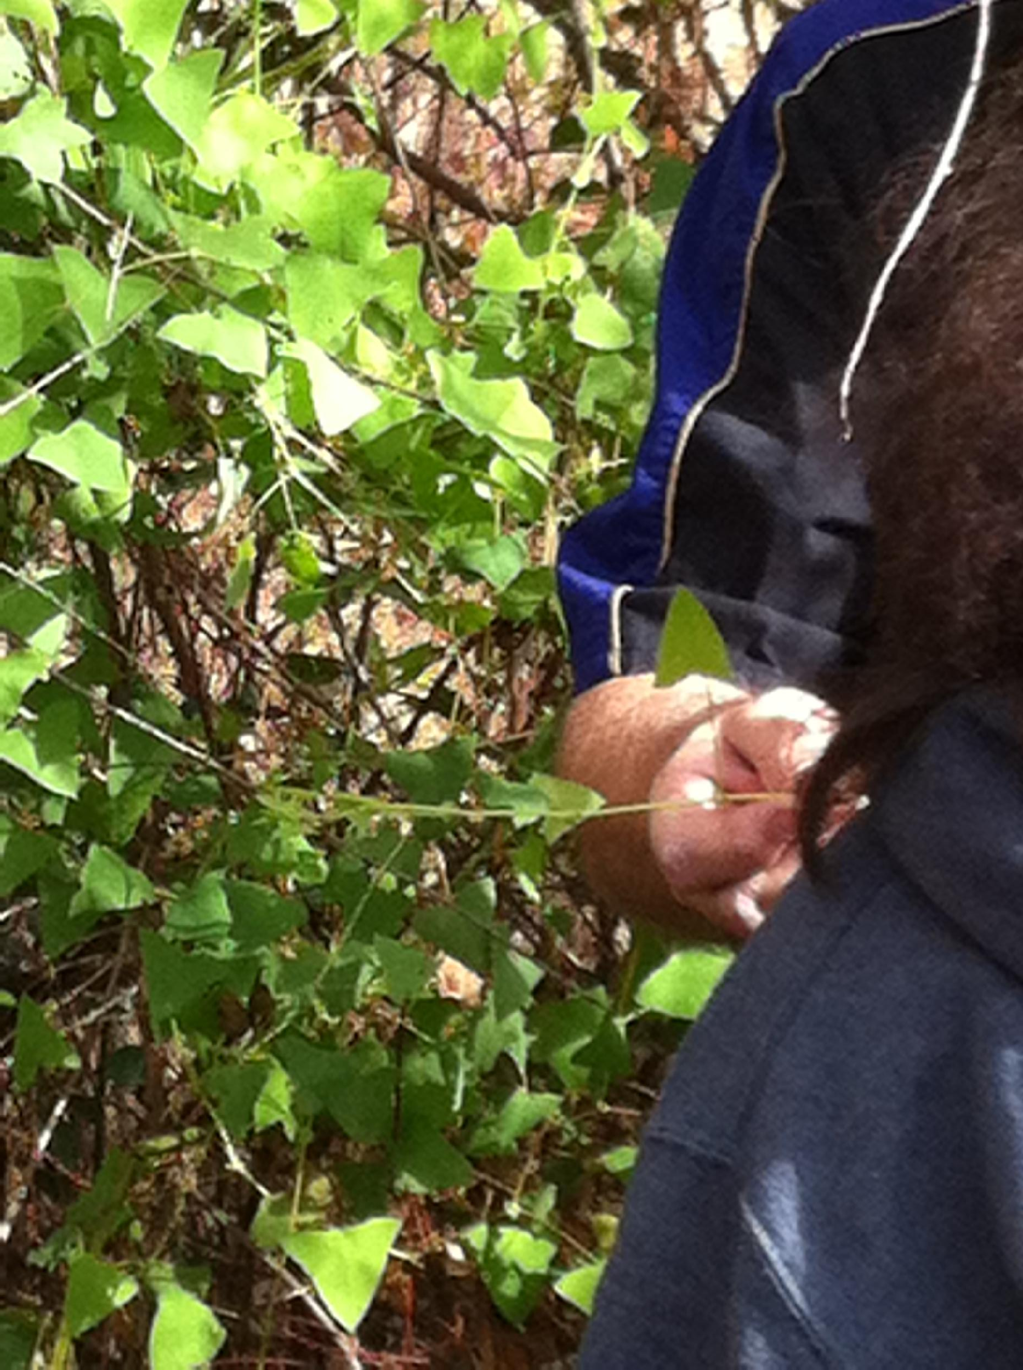
Invasive plant growing around
the pond
Do you know the name of this plant?

Slide 18
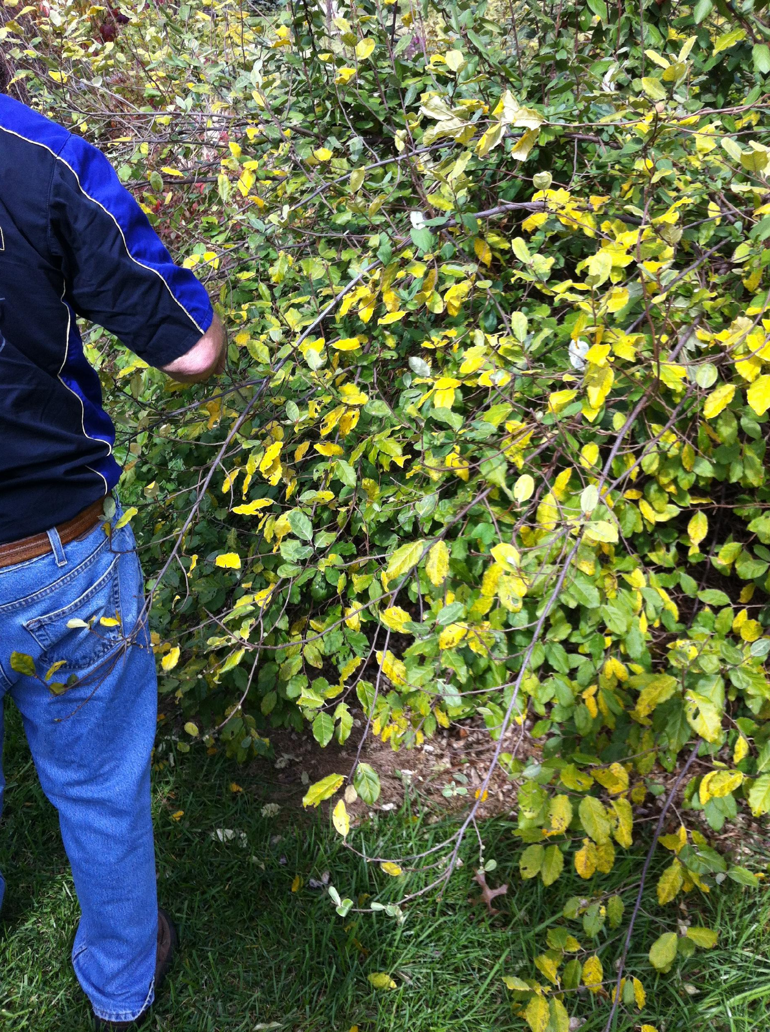
Invasive plant growing around
the pond
Do you know the name of this plant?
We will all know the names of the invasive plants and the native ones by the end of the project

Slide 19
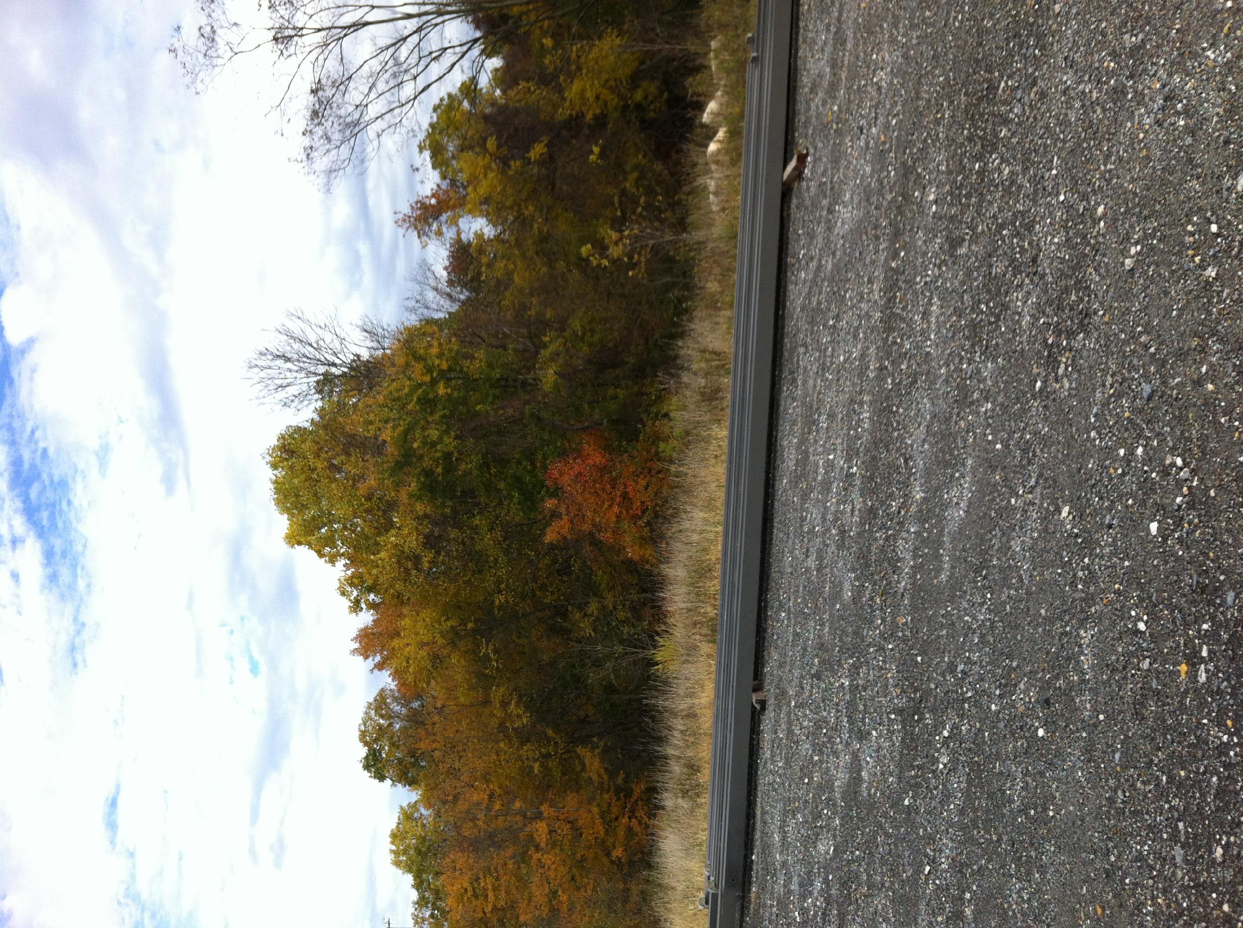
Merriweather Post Pavillion is on the other side of this tree line

Slide 20
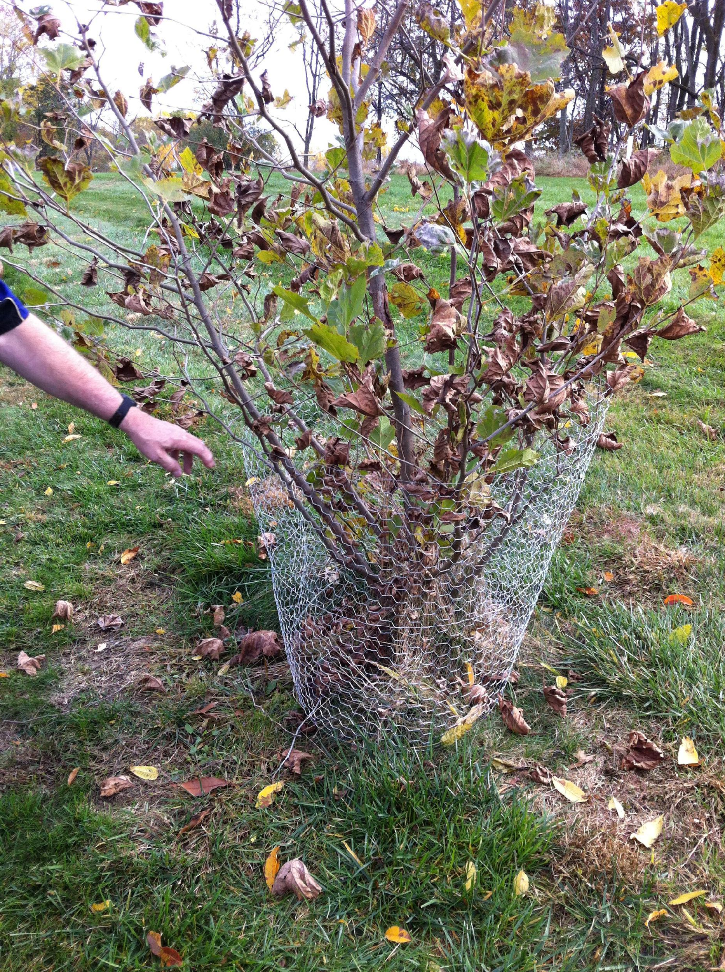
Animals often eat the trees when they are young. Tree guards are needed to prevent wildlife from eating the trees until they are no longer saplings

Slide 21
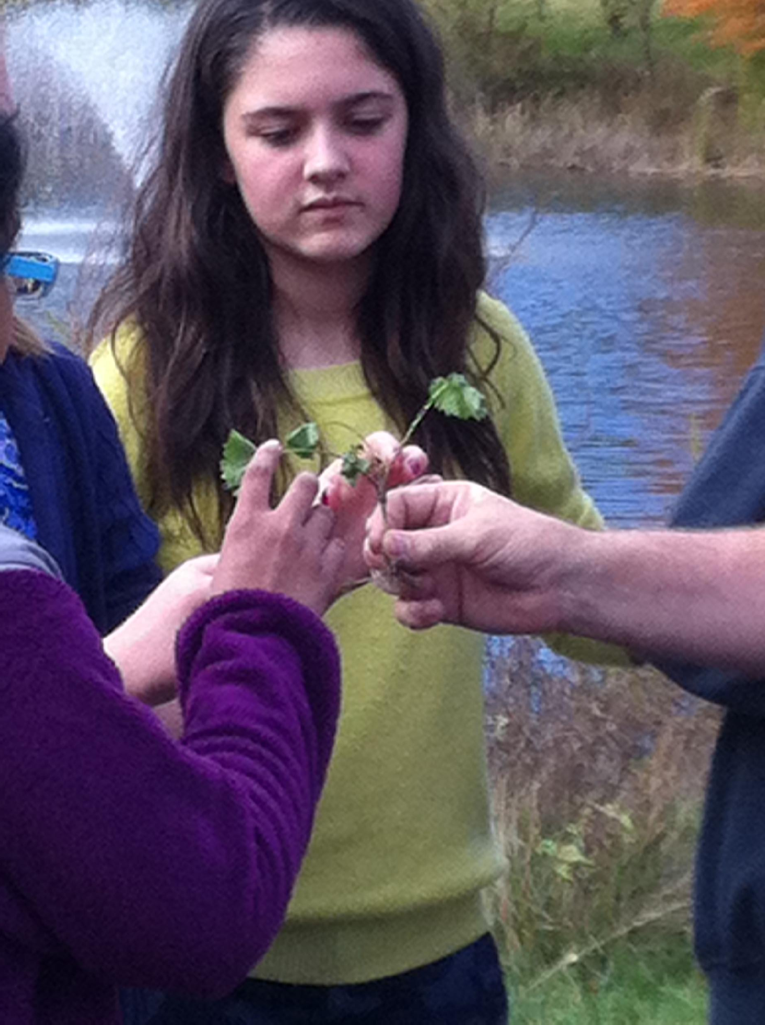
Weird little plant Smells and tastes like a blend of garlic and mustard
One of the original spices used by colonists

Slide 22
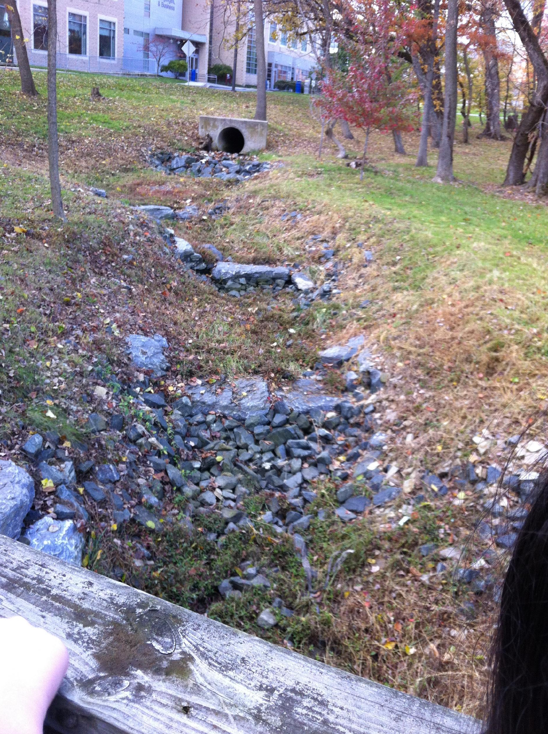
These rocks are place properly to minimize erosion Note that they are placed in flat “step-like” fashion
This causes water to slow down more quickly, preventing it from carrying the soil and possible pollutants closer to the bay

Slide 23
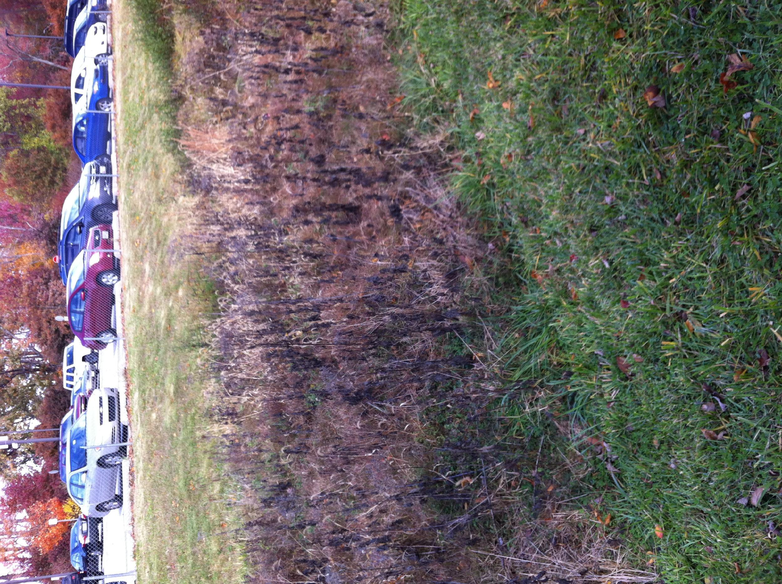
These grasses are native grasses to Maryland
Because they are not weeds (invasives), they last longer during the year, slowing the flow of water, and having deeper roots, they also filter out pollutants, and catch more soil, preventing runoff

Slide 24
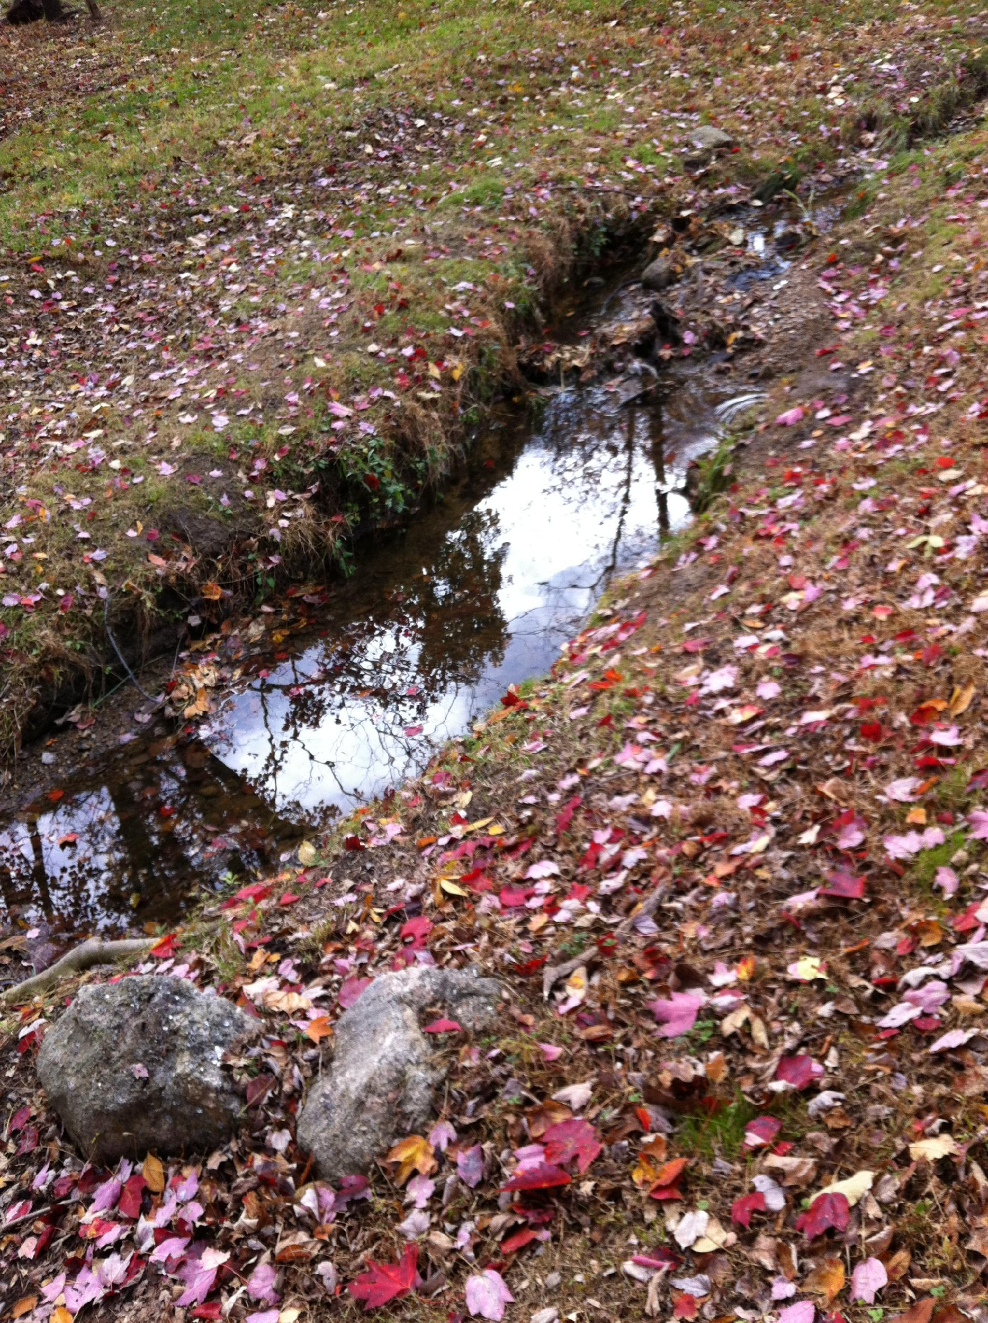
This part of the stream has been fixed
Note the width is much wider
You do not see piles of dirt and other sediment being carried to the bay

Slide 25
HCC Stream Relief:
Remove invasive plants
Remove rocks, debris, and trash
Install native plants
Widen stream waterways
Learn about the habitat close to the bay
Educate others in our community

Slide 26
What to Bring ???
Backpack
Lunch
Water (enough for the day)
(You can bring a water bottle and refill it at the campus when needed)

Slide 27
What to Wear
Pants: Blue jeans or other work pants
Shirt: Button down long sleeve shirt
Not allowed: Shorts (of any kind, jean or sport), sweat pants, and designer jeans with holes

Slide 28
Dress in Layers
Layers: flannel shirt, sweatshirt, coat or jacket
If it is really cold, think about wearing long-johns
or an extra layer of clothes under your pants
Shoes: Sturdy boots recommended. Closed-toe shoes such as sneakers are OK if you don’t have boots
Not allowed: sandals, casual shoes, skate shoes, heels, etc.

Slide 29
Other Stuff to Bring
Sunscreen: UVA/UVB protection (at least SPF 30)
Optional:
Hat
Rain gear
We will provide you with gloves and safety glasses

Slide 30
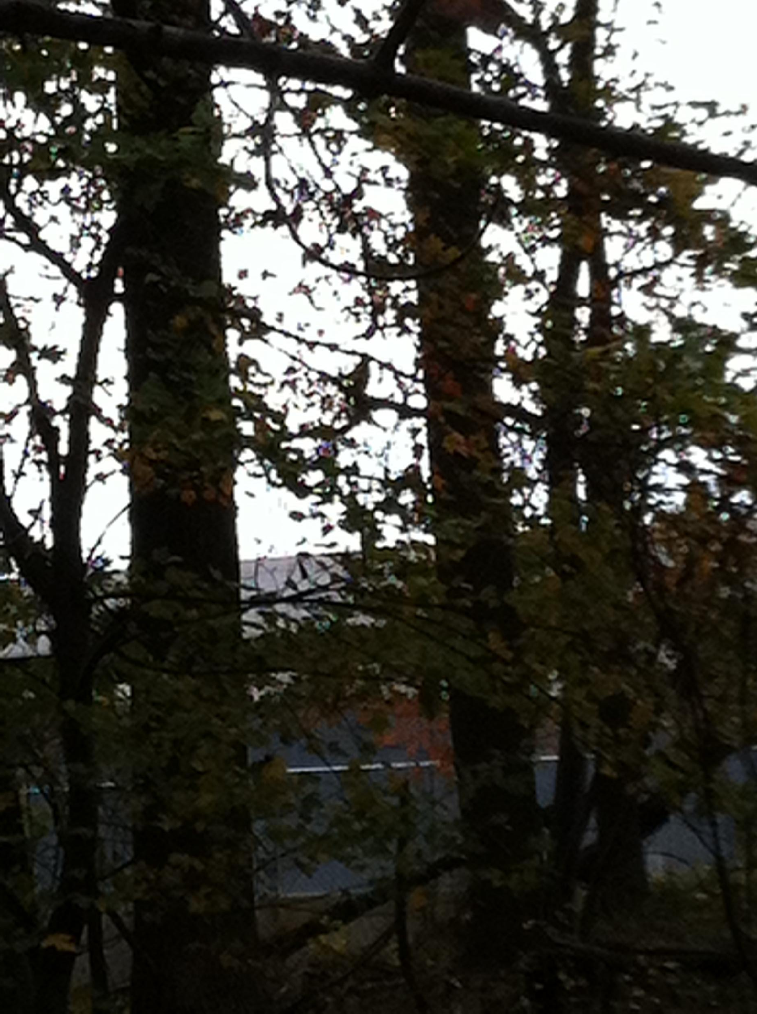
Lots of wildlife at HCC
Can you find the hawk?

Slide 31
Here he is

